Slide 1
Digital Portfolio
STUDENT NAME: Shalini.J
REGISTER NO AND NMID:2428b0150 AND asbruaj2428b0150
DEPARTMENT: School Of Computer Studies
COLLEGE: AVP College Of Art's And Science/Bharathiar University

Slide 2
Digital Portfolio – Banking & Finance Professional Resume Presentation

Slide 3


AGENDA
Problem Statement
Project Overview
End Users
Tools and Technologies
Portfolio design and Layout
Features and Functionality
Results and Screenshots
Conclusion
Github Link
3/21/2024 Annual Review

Slide 4

Analytical, detail-oriented professional with 8+ years of experience in banking. Skilled in handling customer transactions, ensuring accuracy, and solving complex financial issues while delivering excellent service.

Slide 5

Strong background in banking operations and financial management. Expertise in cash handling, documentation, and promoting banking products. Proven ability to work in fast-paced environments with a focus on accuracy and customer satisfaction.

Slide 6

Retail banking customers
Small business clients
Internal staff and management teams
Financial institutions requiring accurate record keeping

Slide 7

Cash Drawer Balancing
Card Handling Skills
Complex Problem Solving
Staff Training & Documentation
Record Handling & Documentation
Exceptional Customer Service
Analytical & Critical Thinking

Slide 8
The portfolio highlights education, professional experience, technical skills, and achievements. Structured to emphasize both professional growth and practical expertise.
8

Slide 9
8+ years of banking experience
Strong customer service orientation
High accuracy in financial transactions
Team leadership and collaboration skills
Recognized for performance and achievements

Slide 10
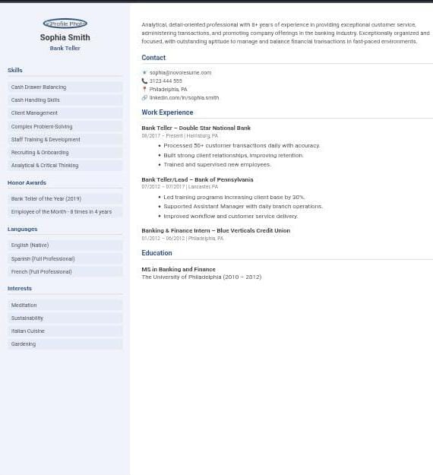

RESULTS AND SCREENSHOTS
3/21/2024 Annual Review
10

Slide 11
With a strong educational foundation in Banking and Finance and extensive professional experience, Shalini. J is well-prepared to contribute effectively in financial services, customer engagement, and operational excellence.
11

